Slide 1
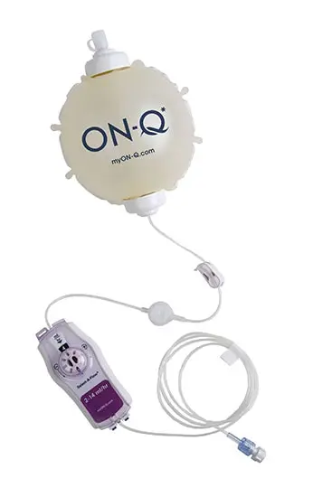
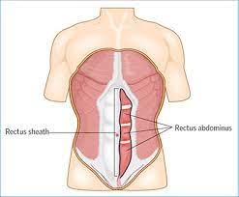
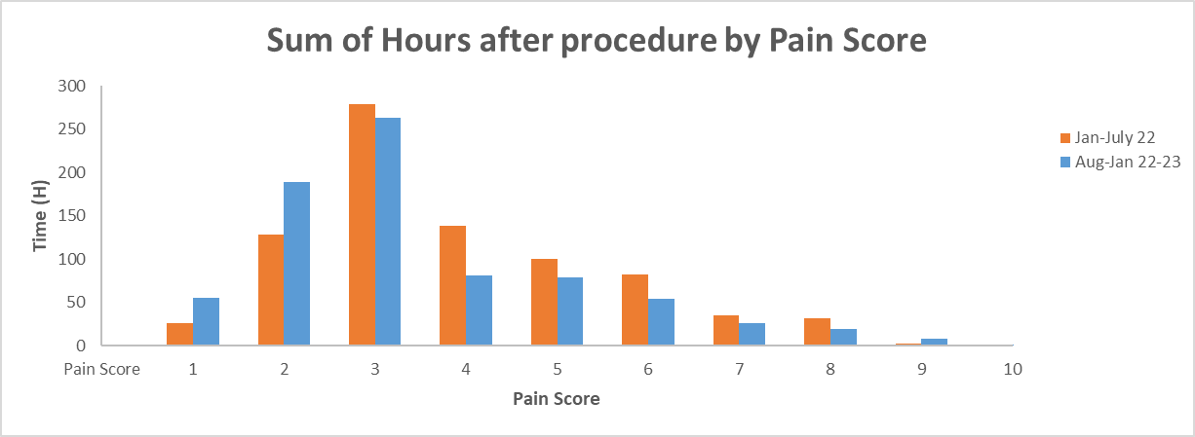
Epidural catheters for rectus sheath/TAP blocks vs elastomeric pumps for postoperative analgesia after laparotomies. A retrospective comparative study.
M. Radwan, S. Elsayed, T. Baker, A. Jain. Anaesthesia Department, Addenbrooke`s Hospital, Cambridge.
INTRODUCTION
PATIENTS AND METHODS:
RESULTS
Elastomeric pumps are mechanical devices composed of balloon reservoir
into which the drug to be infused is stored, a protective casing, a flow
controller and a wound catheter. Elastomeric pumps are frequently used in
providing postoperative analgesia. They are simple to use, provide
continuous infusion with less technical difficulties, require lower amount
of local anaesthetic volume due to multiple apertures along the catheters,
do not require power supply and allow patient ambulation.
However, there are numerous factors that can affect the flow rate of
elastomeric pump such as pressure exerted by the elastomeric balloon,
catheter size, the vertical height of the pump in relation to the wound &
partial filling.
We retrospectively investigated all patients who underwent exploratory laparotomy as the first procedure and receiving local anaesthetic infusion via rectus sheath/TAP catheters at Addenbrooke’s Hospital, Cambridge, between January and July 2022 (epidural catheters for rectus sheath /TAP blocks) and August 2022- January 2023 (Elastomeric pumps). Data was collected from the electronic patient record (EPIC)*.
The parameters we looked at were:
PCA use
Length of stay
Pain scores
Time in recovery
Number of days of catheter infusion
PCA use: Epidural catheter group - 5.8 days (range from 1 to 14 days) vs Elastomeric pump group - 3.29 days (range from 1 to 9 days)
Pain scores: Average pain score - 5 (Epidural catheter group, lowest 1, highest 10), vs Average pain score - 4 (Elastomeric pump group, lowest 1, highest 10).
Length of stay: Epidural catheter group 13 days compared to 11 days in the elastomeric pump group
Time in recovery: 3 hours 32 minutes in the epidural catheter group vs 3 hours 54 minutes in the elastomeric pump group
Average number of days of catheter infusion was 4 days in both groups (range 2 – 4 days).
OBJECTIVES
To compare efficacy of elastomeric pumps vs the epidural catheters for rectus sheath/TAP blocks for postoperative analgesia after laparotomies.
CONCLUSION
Using elastomeric pumps through rectus sheath/ TAP catheters is an effective alternative instead of using epidural catheters for rectus sheath/TAP blocks for analgesia after laparotomies.
REFERENCES
1. Rucklidge M, Beattie E Rectus sheath catheter analgesia for patients undergoing laparotomy BJA education; Volume 18, Issue 6, P166-172, June 2018
2. Bakshi SG, Mapari A, Shylasree TS REctus Sheath for postoperative analgesia in gynaecological ONcology Surgery (RESONS) : a randomised-controlled trial Can J Anaesth 2016; 63: 1335-1344
*Using Qlikview software for data sorting, analysis and visualisation we interrogated our centres Electronic Health Record System, EPIC (EPIC Systems Corporation, Verona, Wisconsin,USA).

